Slide 1
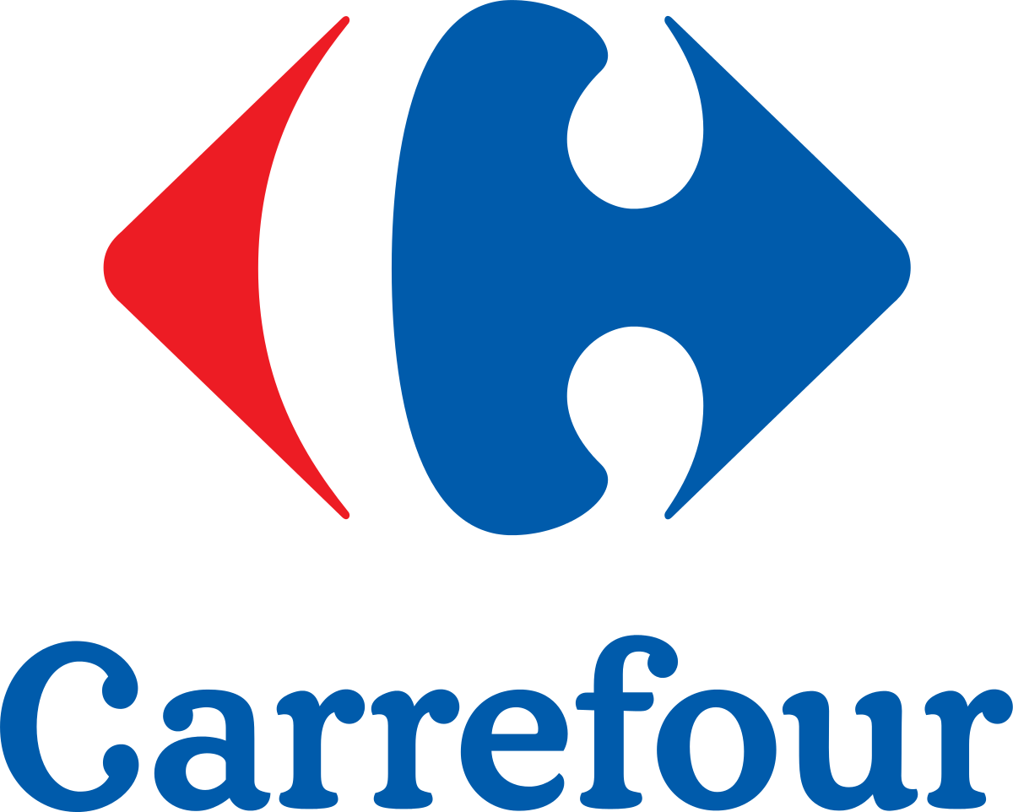
WEB Scrapping project
Camille Libert-Coubard
April 2020

Slide 2
Table of contents
Objective
Web scrapping methodology
Results

Slide 3
Objective
Collect information about products being promoted on Carrefour.com
Understand the promotions, and more specifically:
The number of promotions
The categories and subcatgories being the most promoted
The type of promotion
The brands promoting the most on the website
Project aimed at:
Carrefour competitors
Industrial brands

Slide 4
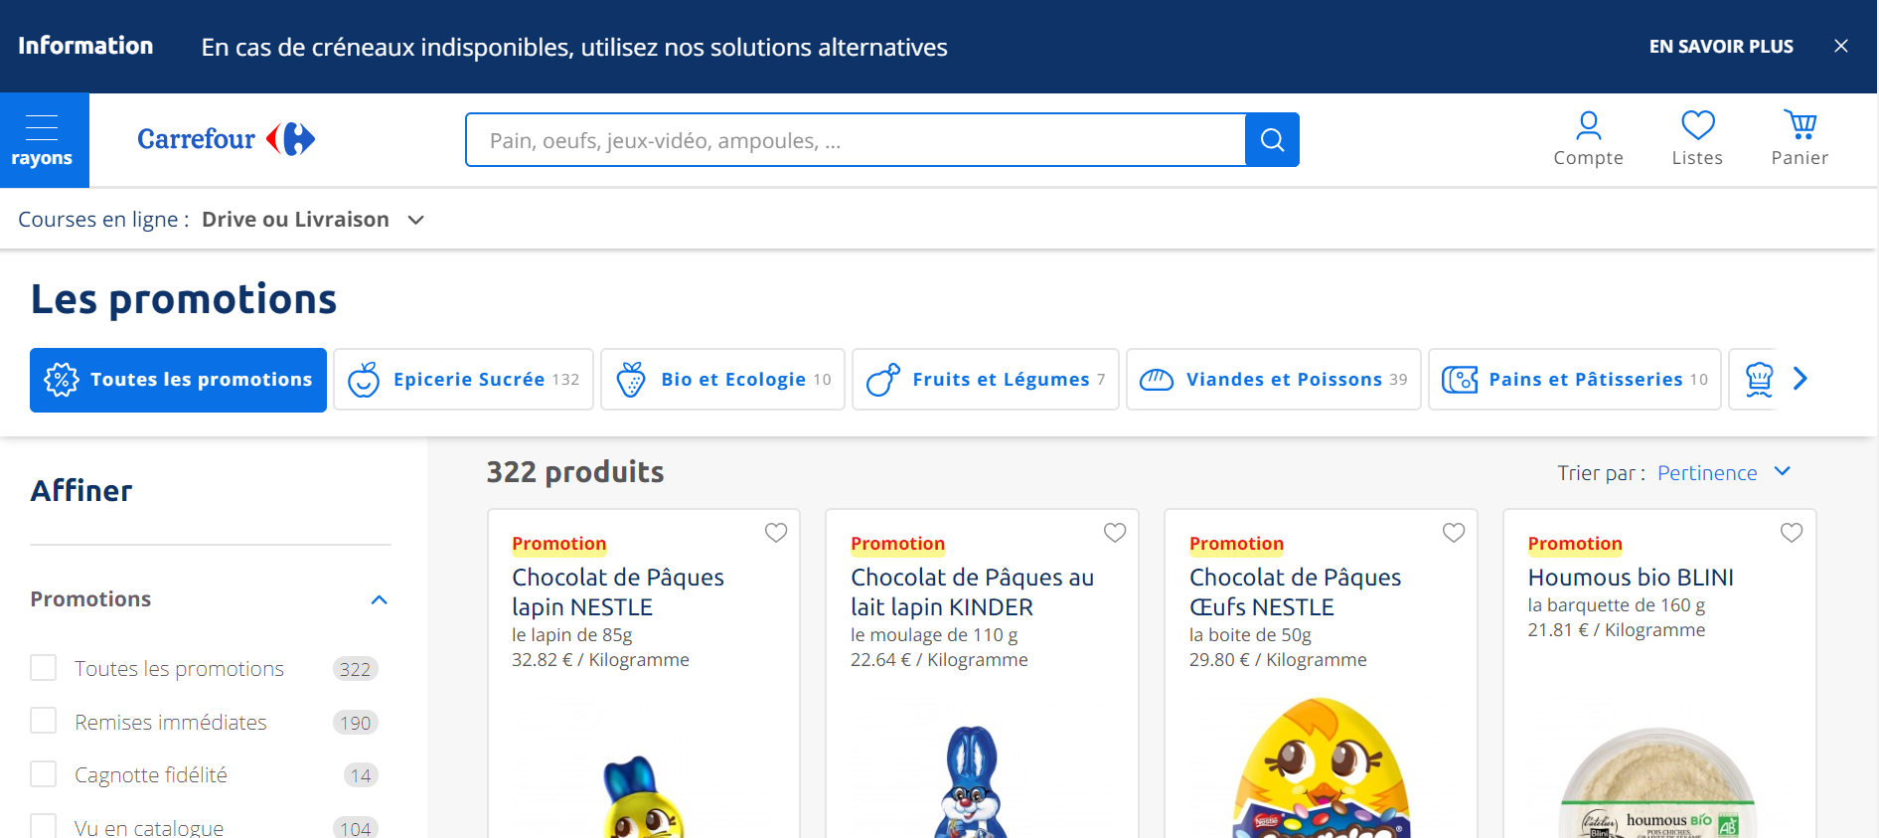
Carrefour webpage
https://www.carrefour.fr/promotions

Slide 5
Web Scrapping methodology

Slide 6
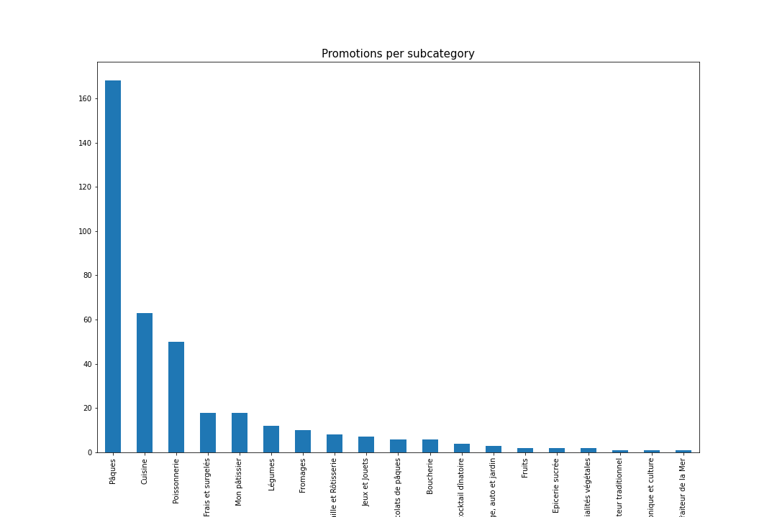
results

